Slide 1
Testing
Testing

Slide 2
Testing Concepts
Testing

Slide 3
Background
Main objectives of a project: High Quality & High Productivity (Q&P)
Quality has many dimensions
  reliability, maintainability, interoperability etc.
Reliability is perhaps the most important
Reliability: The chances of software failing
More defects => more chances of failure => lesser reliability
Hence Q goal: Have as few defects as possible in the delivered software
Testing

Slide 4
Faults & Failure
Failure: A software failure occurs if the behavior of the s/w is different from expected/specified.
Fault: cause of software failure
Fault = bug = defect
Failure implies presence of defects
A defect has the potential to cause failure.
Definition of a defect is environment, project specific
Testing

Slide 5
Role of Testing
Reviews are human processes - can not catch all defects
Hence there will be requirement defects, design defects and coding defects in code
These defects have to be identified by testing
Therefore testing plays a critical role in ensuring quality.
All defects remaining from before as well as new ones introduced have to be identified by testing.
Testing

Slide 6
Detecting defects in Testing
During testing, software under test (SUT) executed with set of test cases
Failure during testing => defects are present
No failure => confidence grows, but can not say “defects are absent”
To detect defects, must cause failures during testing
Testing

Slide 7
Test Oracle
To check if a failure has occurred when executed with a test case, we need to know the correct behavior
I.e. need a test oracle, which is often a human
Human oracle makes each test case expensive as someone has to check the correctness of its output
Testing

Slide 8
Test case and test suite
Test case – a set of test inputs and execution conditions designed to exercise SUT in a particular manner
  Test case should also specify the expected output – oracle uses this to detect failure
Test suite - group of related test cases generally executed together
Testing

Slide 9
Test harness
During testing, for each test case in a test suite, conditions have to be set, SUT called with inputs, output checked against expected to declare fail/pass
Many test frameworks (or test harness) exist that automate the testing process
  Each test case is often a function/method
  A test case sets up the conditions, calls the SUT with the required inputs
  Tests the results through assert statements
  If any assert fails – declares failure
Testing

Slide 10
Levels of Testing
The code contains requirement defects, design defects, and coding defects
Nature of defects is different for different injection stages
One type of testing will be unable to detect the different types of defects
Different levels of testing are used to uncover these defects
Testing

Slide 11
User needs
Acceptance testing
Requirement
specification
System testing
Design
Integration testing
code
Unit testing
Testing

Slide 12
Unit Testing
Different modules tested separately
Focus: defects injected during coding
Essentially a code verification technique, covered in previous chapter
UT is closely associated with coding
Frequently the programmer does UT; coding phase sometimes called “coding and unit testing”
Testing

Slide 13
Integration Testing
Focuses on interaction of modules in a subsystem
Unit tested modules combined to form subsystems
Test cases to “exercise” the interaction of modules in different ways
May be skipped if the system is not too large
Testing

Slide 14
System Testing
Entire software system is tested
Focus: does the software implement the requirements?
Validation exercise for the system with respect to the requirements
Generally the final testing stage before the software is delivered
May be done by independent people
Defects removed by developers
Most time consuming test phase
Testing

Slide 15
Acceptance Testing
Focus: Does the software satisfy user needs?
Generally done by end users/customer in customer environment, with real data
Only after successful AT software is deployed
Any defects found,are removed by developers
Acceptance test plan is based on the acceptance test criteria in the SRS
Testing

Slide 16
Other forms of testing
Performance testing
  tools needed to “measure” performance
Stress testing
  load the system to peak, load generation tools needed
Regression testing
  test that previous functionality works alright
  important when changes are made
  Previous test records are needed for comparisons
  Prioritization of testcases needed when complete test suite cannot be executed for a change
Testing

Slide 17
Testing Process
Testing

Slide 18
Testing
Testing only reveals the presence of defects
Does not identify nature and location of defects
Identifying & removing the defect => role of debugging and rework
Preparing test cases, performing testing, defects identification & removal all consume effort
Overall testing becomes very expensive : 30-50% development cost
Testing

Slide 19
Testing…
Multiple levels of testing are done in a project
At each level, for each SUT, test cases have to be designed and then executed
Overall, testing is very complex in a project and has to be done well
Testing process at a high level has: test planning, test case design, and test execution
Testing

Slide 20
Test Plan
Testing usually starts with test plan and ends with acceptance testing
Test plan is a general document that defines the scope and approach for testing for the whole project
Inputs are SRS, project plan, design
Test plan identifies what levels of testing will be done, what units will be tested, etc in the project
Testing

Slide 21
Test Plan…
Test plan usually contains
  Test unit specs: what units need to be tested separately
  Features to be tested: these may include functionality, performance, usability,…
  Approach: criteria to be used, when to stop, how to evaluate, etc
  Test deliverables
  Schedule and task allocation
Testing

Slide 22
Test case Design
Test plan focuses on testing a project; does not focus on details of testing a SUT
Test case design has to be done separately for each SUT
Based on the plan (approach, features,..) test cases are determined for a unit
Expected outcome also needs to be specified for each test case
Testing

Slide 23
Test case design…
Together the set of test cases should detect most of the defects
Would like the set of test cases to detect any defects, if it exists
Would also like set of test cases to be small - each test case consumes effort
Determining a reasonable set of test case is the most challenging task of testing
Testing

Slide 24
Test case design
The effectiveness and cost of testing depends on the set of test cases
Q: How to determine if a set of test cases is good? I.e. the set will detect most of the defects, and a smaller set cannot catch these defects
No easy way to determine goodness; usually the set of test cases is reviewed by experts
This requires test cases be specified before testing – a key reason for having test case specs
Test case specs are essentially a table
Testing

Slide 25
Test case specifications
Seq.No
Condition
to be tested
Expected
result
successful
Test Data
Testing

Slide 26
Test case specifications…
So for each testing, test case specs are developed, reviewed, and executed
Preparing test case specifications is challenging and time consuming
  Test case criteria can be used
  Special cases and scenarios may be used
Once specified, the execution and checking of outputs may be automated through scripts
  Desired if repeated testing is needed
  Regularly done in large projects
Testing

Slide 27
Test case execution
Executing test cases may require drivers or stubs to be written; some tests can be auto, others manual
  A separate test procedure document may be prepared
Test summary report is often an output – gives a summary of test cases executed, effort, defects found, etc
Monitoring of testing effort is important to ensure that sufficient time is spent
Computer time also is an indicator of how testing is proceeding
Testing

Slide 28
Defect logging and tracking
A large software may have thousands of defects, found by many different people
Often person who fixes (usually the coder) is different from who finds
Due to large scope, reporting and fixing of defects cannot be done informally
Defects found are usually logged in a defect tracking system and then tracked to closure
Defect logging and tracking is one of the best practices in industry
Testing

Slide 29
Defect logging…
A defect in a software project has a life cycle of its own, like
  Found by someone, sometime and logged along with info about it (submitted)
  Job of fixing is assigned; person debugs and then fixes (fixed)
  The manager or the submitter verifies that the defect is indeed fixed (closed)
More elaborate life cycles possible
Testing

Slide 30
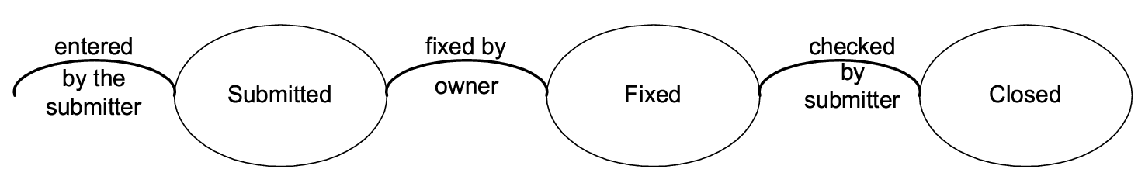
Defect logging…
Testing

Slide 31
Defect logging…
During the life cycle, info about defect is logged at diff stages to help debug as well as analysis
Defects generally categorized into a few types, and type of defects is recorded
  ODC is one classification
  Some std categories: Logic, standards, UI, interface, performance, documentation,..
Testing

Slide 32
Defect logging…
Severity of defects in terms of its impact on sw is also recorded
Severity useful for prioritization of fixing
One categorization
  Critical: Show stopper
  Major: Has a large impact
  Minor: An isolated defect
  Cosmetic: No impact on functionality
Testing

Slide 33
Defect logging…
Ideally, all defects should be closed
Sometimes, organizations release software with known defects (hopefully of lower severity only)
Organizations have standards for when a product may be released
Defect log may be used to track the trend of how defect arrival and fixing is happening
Testing

Slide 34
Black Box Testing
Testing

Slide 35
Role of Test cases
Ideally would like the following for test cases
  No failure implies “no defects” or “high quality”
  If defects present, then some test case causes a failure
Role of test cases is clearly very critical
Only if test cases are “good”, the confidence increases after testing
Testing

Slide 36
Test case design
During test planning, have to design a set of test cases that will detect defects present
Some criteria needed to guide test case selection
Two approaches to design test cases
  functional or black box
  structural or white box
Both are complimentary; we discuss a few approaches/criteria for both
Testing

Slide 37
Black Box testing
Software tested to be treated as a block box
Specification for the black box is given
The expected behavior of the system is used to design test cases
i.e test cases are determined solely from specification.
Internal structure of code not used for test case design
Testing

Slide 38
Black box Testing…
Premise: Expected behavior is specified.
Hence just test for specified expected behavior
How it is implemented is not an issue.
For modules,specification produced in design specify expected behavior
For system testing, SRS specifies expected behavior
Testing

Slide 39
Black Box Testing…
Most thorough functional testing - exhaustive testing
  Software is designed to work for an input space
  Test the software with all elements in the input space
Infeasible - too high a cost
Need better method for selecting test cases
Different approaches have been proposed
Testing

Slide 40
Equivalence Class partitioning
Divide the input space into equivalent classes
If the software works for a test case from a class the it is likely to work for all
Can reduce the set of test cases if such equivalent classes can be identified
Getting ideal equivalent classes is impossible
Approximate it by identifying classes for which different behavior is specified
Testing

Slide 41
Equivalence class partitioning…
Rationale: specification requires same behavior for elements in a class
Software likely to be constructed such that it either fails for all or for none.
E.g. if a function was not designed for negative numbers then it will fail for all the negative numbers
For robustness, should form equivalent classes for invalid inputs also
Testing

Slide 42
Equivalent class partitioning..
Every condition specified as input is an equivalent class
Define invalid equivalent classes also
E.g. range 0< value<Max specified
  one range is the valid class
  input < 0 is an invalid class
  input > max is an invalid class
Whenever that entire range may not be treated uniformly - split into classes
Testing

Slide 43
Equivalent class partitioning..
Should consider eq. classes in outputs also and then give test cases for different classes
E.g.: Compute rate of interest given loan amount, monthly installment, and number of months
  Equivalent classes in output: + rate, rate = 0 ,-ve rate
  Have test cases to get these outputs
Testing

Slide 44
Equivalence class…
Once eq classes selected for each of the inputs, test cases have to be selected
  Select each test case covering as many valid eq classes as possible
  Or, have a test case that covers at most one valid class for each input
  Plus a separate test case for each invalid class
Testing

Slide 45
Example
Consider a program that takes 2 inputs – a string s and an integer n
Program determines n most frequent characters
Tester believes that programmer may deal with diff types of chars separately
A set of valid and invalid equivalence classes is given
Testing

Slide 46
Example..
Input | Valid Eq Class | Invalid Eq class
S | 1: Contains numbers 2: Lower case letters 3: upper case letters 4: special chars 5: str len between 0-N(max) | 1: non-ascii char 2: str len > N
N | 6: Int in valid range | 3: Int out of range
Testing

Slide 47
Example…
Test cases (i.e. s , n) with first method
  s : str of len < N with lower case, upper case, numbers, and special chars, and n=5
  Plus test cases for each of the invalid eq classes
  Total test cases: 1+3= 4
With the second approach
  A separate str for each type of char (i.e. a str of numbers, one of lower case, …) + invalid cases
  Total test cases will be 5 + 2 = 7
Testing

Slide 48
Boundary value analysis
Programs often fail on special values
These values often lie on boundary of equivalence classes
Test cases that have boundary values have high yield
These are also called extreme cases
A BV test case is a set of input data that lies on the edge of a eq class of input/output
Testing

Slide 49
BVA...
For each equivalence class
  choose values on the edges of the class
  choose values just outside the edges
E.g. if 0 <= x <= 1.0
  0.0 , 1.0 are edges inside
  -0.1,1.1 are just outside
E.g. a bounded list - have a null list , a maximum value list
Consider outputs also and have test cases generate outputs on the boundary
Testing

Slide 50
BVA…
In BVA we determine the value of vars that should be used
If input is a defined range, then there are 6 boundary values plus 1 normal value (tot: 7)
If multiple inputs, how to combine them into test cases; two strategies possible
  Try all possible combination of BV of diff variables, with n vars this will have 7^{n} test cases!
  Select BV for one var; have other vars at normal values + 1 of all normal values
Testing

Slide 51
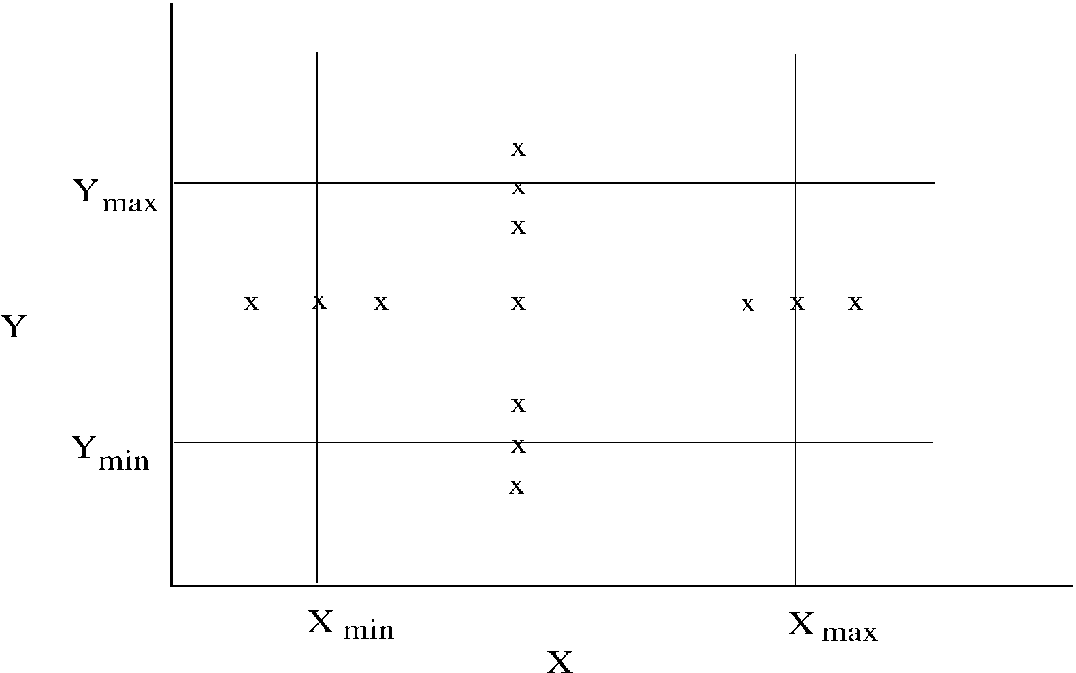
BVA.. (test cases for two vars – x and y)
Testing

Slide 52
Pair-wise testing
Often many parmeters determine the behavior of a software system
The parameters may be inputs or settings, and take diff values (or diff value ranges)
Many defects involve one condition (single-mode fault), eg. sw not being able to print on some type of printer
  Single mode faults can be detected by testing for different values of diff parms
  If n parms and each can take m values, we can test for one diff value for each parm in each test case
  Total test cases: m
Testing

Slide 53
Pair-wise testing…
All faults are not single-mode and sw may fail at some combinations
  Eg tel billing sw does not compute correct bill for night time calling (one parm) to a particular country (another parm)
  Eg ticketing system fails to book a biz class ticket (a parm) for a child (a parm)
Multi-modal faults can be revealed by testing diff combination of parm values
This is called combinatorial testing
Testing

Slide 54
Pair-wise testing…
Full combinatorial testing not feasible
  For n parms each with m values, total combinations are n^{m}
  For 5 parms, 5 values each (tot: 3125), if one test is 5 mts, tot time > 1 month!
Research suggests that most such faults are revealed by interaction of a pair of values
I.e. most faults tend to be double-mode
For double mode, we need to exercise each pair – called pair-wise testing
Testing

Slide 55
Pair-wise testing…
In pair-wise, all pairs of values have to be exercised in testing
If n parms with m values each, between any 2 parms we have m*m pairs
  1st parm will have m*m with n-1 others
  2nd parm will have m*m pairs with n-2
  3rd parm will have m*m pairs with n-3, etc.
  Total no of pairs are m*m*n*(n-1)/2
Testing

Slide 56
Pair-wise testing…
A test case consists of some setting of the n parameters
Smallest set of test cases when each pair is covered once only
A test case can cover a maximum of (n-1)+(n-2)+…=n(n-1)/2 pairs
In the best case when each pair is covered exactly once, we will have m² different test cases providing the full pair-wise coverage
Testing

Slide 57
Pair-wise testing…
Generating the smallest set of test cases that will provide pair-wise coverage is non-trivial
Efficient algos exist; efficiently generating these test cases can reduce testing effort considerably
  In an example with 13 parms each with 3 values pair-wise coverage can be done with 15 testcases
Pair-wise testing is a practical approach that is widely used in industry
Testing

Slide 58
Pair-wise testing, Example
A sw product for multiple platforms and uses browser as the interface, and is to work with diff OSs
We have these parms and values
  OS (parm A): Windows, Solaris, Linux
  Mem size (B): 128M, 256M, 512M
  Browser (C): IE, Netscape, Mozilla
Total no of pair wise combinations: 27
No of cases can be less
Testing

Slide 59
Pair-wise testing…
Test case | Pairs covered
a1, b1, c1 a1, b2, c2 a1, b3, c3 a2, b1, c2 a2, b2, c3 a2, b3, c1 a3, b1, c3 a3, b2, c1 a3, b3, c2 | (a1,b1) (a1, c1) (b1,c1) (a1,b2) (a1,c2) (b2,c2) (a1,b3) (a1,c3) (b3,c3) (a2,b1) (a2,c2) (b1,c2) (a2,b2) (a2,c3) (b2,c3) (a2,b3) (a2,c1) (b3,c1) (a3,b1) (a3,c3) (b1,c3) (a3,b2) (a3,c1) (b2,c1) (a3,b3) (a3,c2) (b3,c2)
Testing

Slide 60
Special cases
Programs often fail on special cases
These depend on nature of inputs, types of data structures,etc.
No good rules to identify them
One way is to guess when the software might fail and create those test cases
Also called error guessing
Play the sadist & hit where it might hurt
Testing

Slide 61
Error Guessing
Use experience and judgement to guess situations where a programmer might make mistakes
Special cases can arise due to assumptions about inputs, user, operating environment, business, etc.
E.g. A program to count frequency of words
  file empty, file non existent, file only has blanks, contains only one word, all words are same, multiple consecutive blank lines, multiple blanks between words, blanks at the start, words in sorted order, blanks at end of file, etc.
Perhaps the most widely used in practice
Testing

Slide 62
State-based Testing
Some systems are state-less: for same inputs, same behavior is exhibited
Many systems’ behavior depends on the state of the system i.e. for the same input the behavior could be different
I.e. behavior and output depend on the input as well as the system state
System state – represents the cumulative impact of all past inputs
State-based testing is for such systems
Testing

Slide 63
State-based Testing…
A system can be modeled as a state machine
The state space may be too large (is a cross product of all domains of vars)
The state space can be partitioned in a few states, each representing a logical state of interest of the system
State model is generally built from such states
Testing

Slide 64
State-based Testing…
A state model has four components
  States: Logical states representing cumulative impact of past inputs to system
  Transitions: How state changes in response to some events
  Events: Inputs to the system
  Actions: The outputs for the events
Testing

Slide 65
State-based Testing…
State model shows what transitions occur and what actions are performed
Often state model is built from the specifications or requirements
The key challenge is to identify states from the specs/requirements which capture the key properties but is small enough for modeling
Testing

Slide 66
State-based Testing, example…
Consider the student survey example (discussed in Chap 4)
  A system to take survey of students
  Student submits survey and is returned results of the survey so far
  The result may be from the cache (if the database is down) and can be up to 5 surveys old
Testing

Slide 67
State-based Testing, example…
In a series of requests, first 5 may be treated differently
Hence, we have two states: one for req no 1-4 (state 1), and other for 5 (2)
The db can be up or down, and it can go down in any of the two states (3-4)
Once db is down, the system may get into failed state (5), from where it may recover
Testing

Slide 68
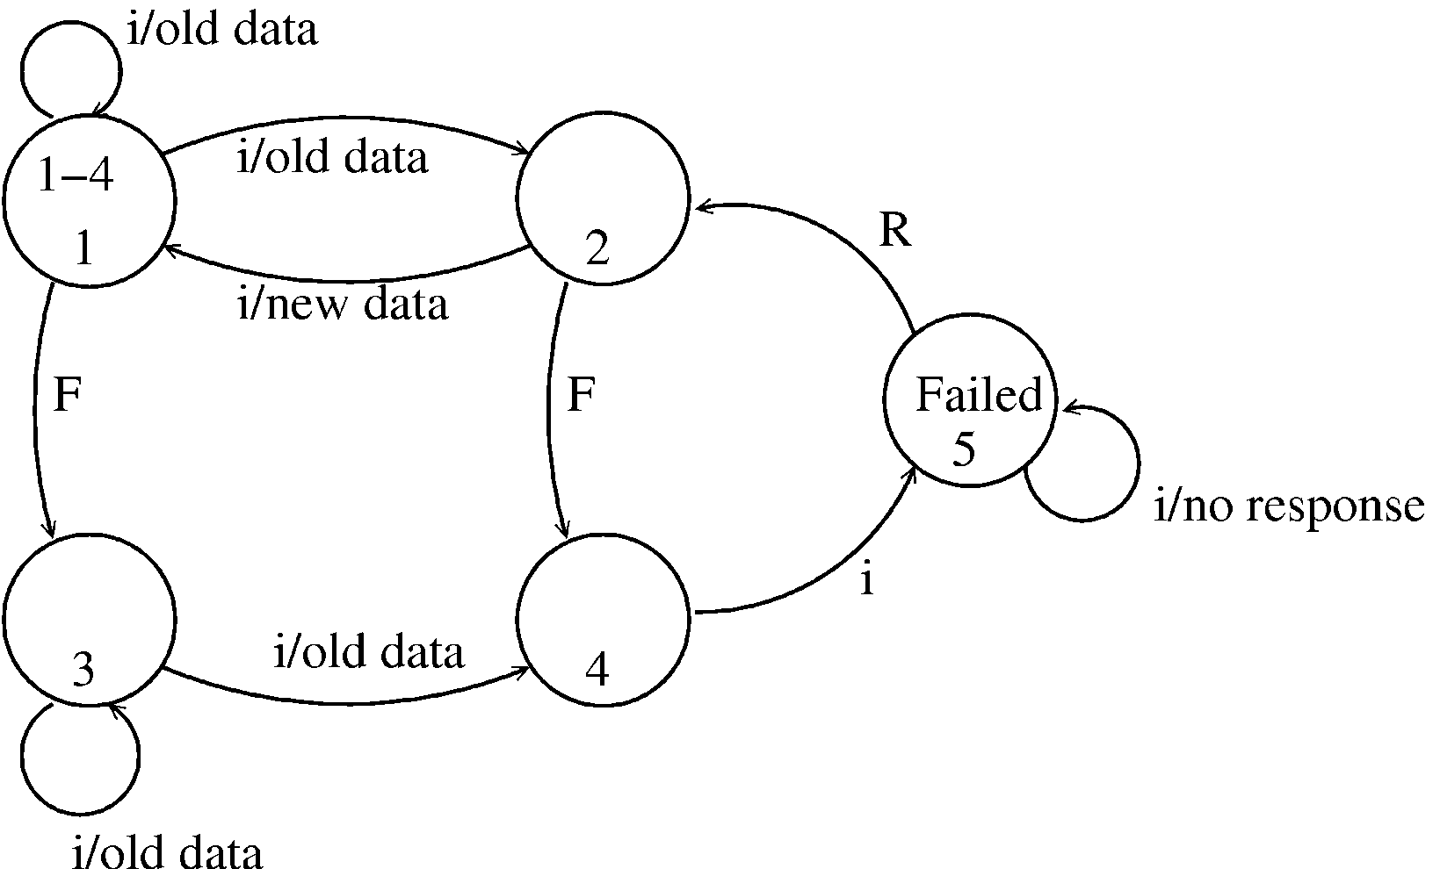
State-based Testing, example…
Testing

Slide 69
State-based Testing…
State model can be created from the specs or the design
For objects, state models are often built during the design process
Test cases can be selected from the state model and later used to test an implementation
Many criteria possible for test cases
Testing

Slide 70
State-based Testing criteria
All transaction coverage (AT): test case set T must ensure that every transition is exercised
All transitions pair coverage (ATP). T must execute all pairs of adjacent transitions (incoming and outgoing transition in a state)
Transition tree coverage (TT). T must execute all simple paths (i.e. a path from start to end or a state it has visited)
Testing

Slide 71
Example, test cases for AT criteria
SNo | Transition | Test case
1 2 3 4 5 6 7 8 | 1 -> 2 1 -> 2 2 -> 1 1 -> 3 3 -> 3 3 -> 4 4 -> 5 5 -> 2 | Req() Req(); req(); req(); req();req(); req() Seq for 2; req() Req(); fail() Req(); fail(); req() Req(); fail(); req(); req(); req();req(); req() Seq for 6; req() Seq for 6; req(); recover()
Testing

Slide 72
State-based testing…
SB testing focuses on testing the states and transitions to/from them
Different system scenarios get tested; some easy to overlook otherwise
State model is often done after design information is available
Hence it is sometimes called grey box testing (as it not pure black box)
Testing

Slide 73
White Box Testing
Testing

Slide 74
White box testing
Black box testing focuses only on functionality
  What the program does; not how it is implemented
White box testing focuses on implementation
  Aim is to exercise different program structures with the intent of uncovering errors
Is also called structural testing
Various criteria exist for test case design
Test cases have to be selected to satisfy coverage criteria
Testing

Slide 75
Types of structural testing
Control flow based criteria
  looks at the coverage of the control flow graph
Data flow based testing
  looks at the coverage in the definition-use graph
Mutation testing
  looks at various mutants of the program
We will discuss only control flow based criteria – these are most commonly used
Testing

Slide 76
Control flow based criteria
Considers the program as control flow graph
  Nodes represent code blocks – i.e. set of statements always executed together
  An edge (i,j) represents a possible transfer of control from i to j
Assume a start node and an end node
A path is a sequence of nodes from start to end
Testing

Slide 77
Statement Coverage Criterion
Criterion: Each statement is executed at least once during testing
I.e. set of paths executed during testing should include all nodes
Limitation: does not require a decision to evaluate to false if no else clause
E.g. : abs (x) : if ( x>=0) x = -x; return(x)
  The set of test cases {x = 0} achieves 100% statement coverage, but error not detected
Guaranteeing 100% coverage not always possible due to possibility of unreachable nodes
Testing

Slide 78
Branch coverage
Criterion: Each edge should be traversed at least once during testing
i.e. each decision must evaluate to both true and false during testing
Branch coverage implies stmt coverage
If multiple conditions in a decision, then all conditions need not be evaluated to T and F
Testing

Slide 79
Control flow based…
There are other criteria too - path coverage, predicate coverage, cyclomatic complexity based, ...
None is sufficient to detect all types of defects (e.g. a program missing some paths cannot be detected)
They provide some quantitative handle on the breadth of testing
More used to evaluate the level of testing rather than selecting test cases
Testing

Slide 80
Tool support and test case selection
Two major issues for using these criteria
  How to determine the coverage
  How to select test cases to ensure coverage
For determining coverage - tools are essential
Tools also tell which branches and statements are not executed
Test case selection is mostly manual - test plan is to be augmented based on coverage data
Testing

Slide 81
In a Project
Both functional and structural should be used
Test plans are usually determined using functional methods; during testing, for further rounds, based on the coverage, more test cases can be added
Structural testing is useful at lower levels only; at higher levels ensuring coverage is difficult
Hence, a combination of functional and structural at unit testing
Functional testing (but monitoring of coverage) at higher levels
Testing

Slide 82
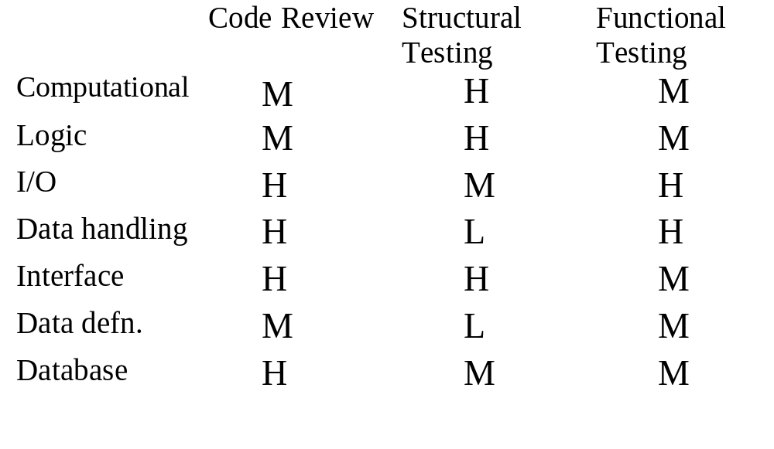
Comparison
Testing

Slide 83
Metrics
Testing

Slide 84
Data
Defects found are generally logged
The log forms the basic data source for metrics and analysis during testing
Main questions of interest for which metrics can be used
  How good is the testing that has been done so far?
  What is the quality or reliability of software after testing is completed?
Testing

Slide 85
Coverage Analysis
Coverage is very commonly used to evaluate the thoroughness of testing
This is not white box testing, but evaluating the overall testing through coverage
Organization sometimes have guidelines for coverage, particularly at unit level (say 90% before checking code in)
Coverage of requirements also checked – often by evaluating the test suites against requirements
Testing

Slide 86
Reliability Estimation
High reliability is an important goal to be achieved by testing
Reliability is usually quantified as a probability or a failure rate or mean time to failure
  R(t) = P(X > t)
  MTTF = mean time to failure
  Failure rate
For a system reliability can be measured by counting failures over a period of time
Measurement often not possible for software as due to fixes reliability changes, and with one-off, not possible to measure
Testing

Slide 87
Reliability Estimation…
Sw reliability estimation models are used to model the failure followed by fix model of software
Data about failures and their times during the last stages of testing is used by these model
These models then use this data and some statistical techniques to predict the reliability of the software
Software reliability growth models are quite complex and sophisticated
Testing

Slide 88
Reliability Estimation
Simple method of measuring reliability achieved during testing
  Failure rate, measured by no of failures in some duration
For using this for prediction, assumed that during this testing software is used as it will be by users
Execution time is often used for failure rate, it can be converted to calendar time
Testing

Slide 89
Defect removal efficiency
Basic objective of testing is to identify defects present in the programs
Testing is good only if it succeeds in this goal
Defect removal efficiency of a QC activity = % of present defects detected by that QC activity
High DRE of a quality control activity means most defects present at the time will be removed
Testing
Notes:
22

Slide 90
Defect removal efficiency …
DRE for a project can be evaluated only when all defects are know, including delivered defects
Delivered defects are approximated as the number of defects found in some duration after delivery
The injection stage of a defect is the stage in which it was introduced in the software, and detection stage is when it was detected
  These stages are typically logged for defects
With injection and detection stages of all defects, DRE for a QC activity can be computed
Testing
Notes:
25

Slide 91
Defect Removal Efficiency …
DREs of different QC activities are a process property - determined from past data
Past DRE can be used as expected value for this project
Process followed by the project must be improved for better DRE
Testing
Notes:
26

Slide 92
Summary
Testing plays a critical role in removing defects, and in generating confidence
Testing should be such that it catches most defects present, i.e. a high DRE
Multiple levels of testing needed for this
Incremental testing also helps
At each testing, test cases should be specified, reviewed, and then executed
Testing

Slide 93
Summary …
Deciding test cases during planning is the most important aspect of testing
Two approaches – black box and white box
Black box testing - test cases derived from specifications.
  Equivalence class partitioning, boundary value, cause effect graphing, error guessing
White box - aim is to cover code structures
  statement coverage, branch coverage
Testing

Slide 94
Summary…
In a project both used at lower levels
  Test cases initially driven by functional
  Coverage measured, test cases enhanced using coverage data
At higher levels, mostly functional testing done; coverage monitored to evaluate the quality of testing
Defect data is logged, and defects are tracked to closure
The defect data can be used to estimate reliability, DRE
Testing

